Slide 1
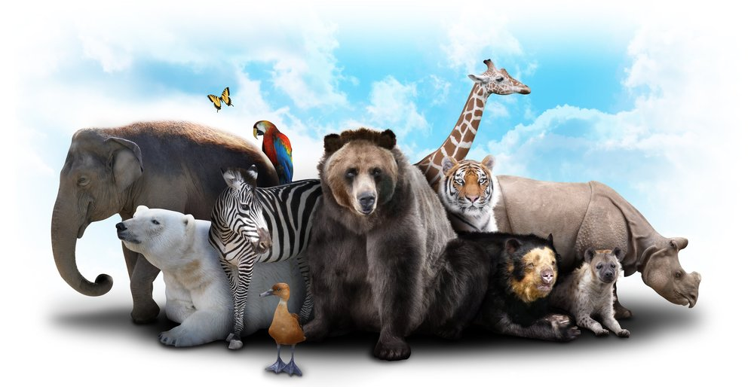
Zoo Animal Classification
Dhamastya Adhi
Dimas Pulung Herjuno
Estri Puji Lestari

Slide 2
Business Understanding
Problem : a lot of traits to describe an animal but we don’t know which class is that animal belong to.
Clear Question : How can we know the class of an animal based on data of their traits like hair, feathers, egg, backbone, etc?
Measurable Outcome : Class Type of Animals

Slide 3
Analytical Approach
K Nearest Neighbours (KNN)
KNN is supervised ML.
We use this model because we have two datasets (zoo.csv & class.csv).
In zoo.csv already given with class_type column which is the same as classification_number column in class.csv.
We can train the datasets by merge two datasets.

Slide 4
Data Requirement
Traits of animals :
Is it have hair, feathers, eggs, milk, tooth, backbone, fins, legs, tail?
Is it airborne, aquatic, predator, breathes, venomous?
Is it domestic or catsize?
Class Type of animals

Slide 5
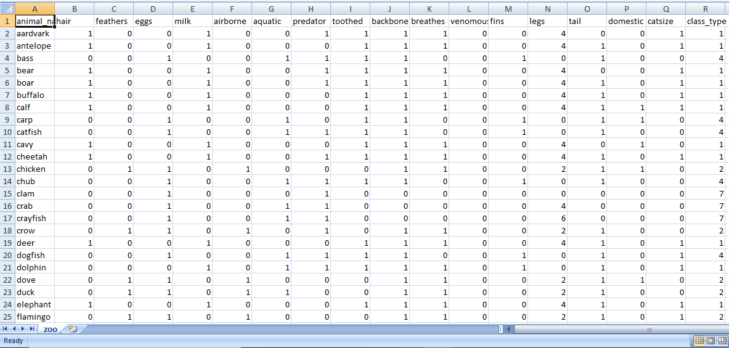
Data Collection
We collect data from kaggle
(https://www.kaggle.com/uciml/zoo-animal-classification)
zoo.csv (102x18)

Slide 6
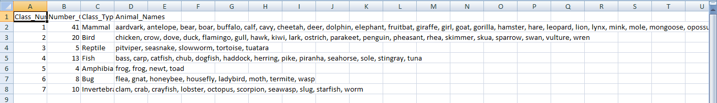
Data Collection
class.csv (8x4)

Slide 7
Data Understanding
zoo.csv : contain data about traits of animal, animal names, number of class type
animal_name(Unique for each instance),
hair, feathers, eggs, milk, airborne, aquatic, predator, toothed, backbone, breathes, venomous, fins, tail, domestic, catsize (in boolean type)
legs (in numeric (set of values: {0,2,4,5,6,8}))
class_type (in numeric (integer values in range [1,7]))

Slide 8
Data Understanding
class.csv : contain class type, number of class type, number of animals within class type, animal names belong to each class type
Class_Number (in numeric (integer values in range [1,7]))
Number_Of_Animal_Species_In_Class (in numeric)
Class_Type (in character -- The actual word description of the class)
Animal_Names (in character -- The list of the animals that fall in the category of the class)

Slide 9
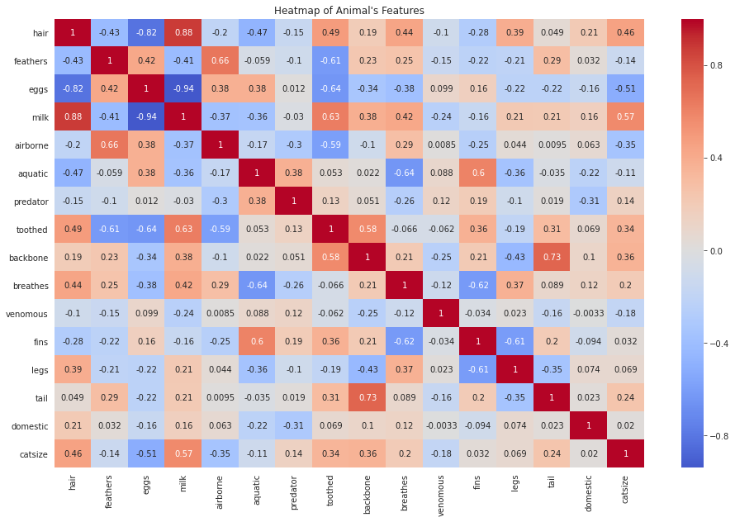
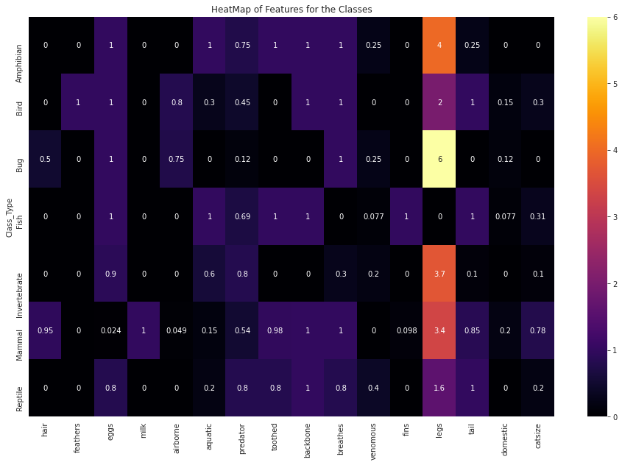
Data Understanding

Slide 10
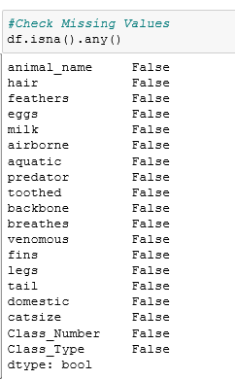
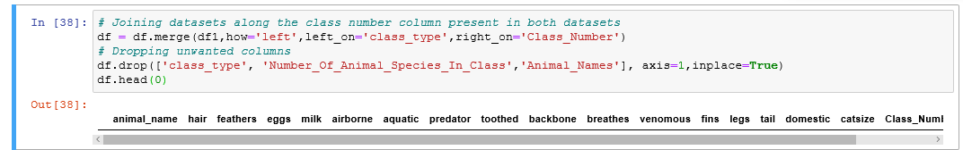
Data Preparation
1.CHECK MISSING VALUE
2.MERGE 2 DATA

Slide 11
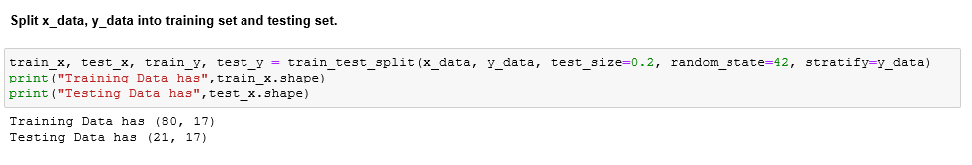
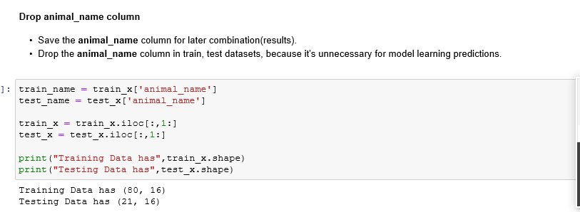
Modelling
2. DROP USELESS COLUMN
1. SPLIT THE DATA

Slide 12
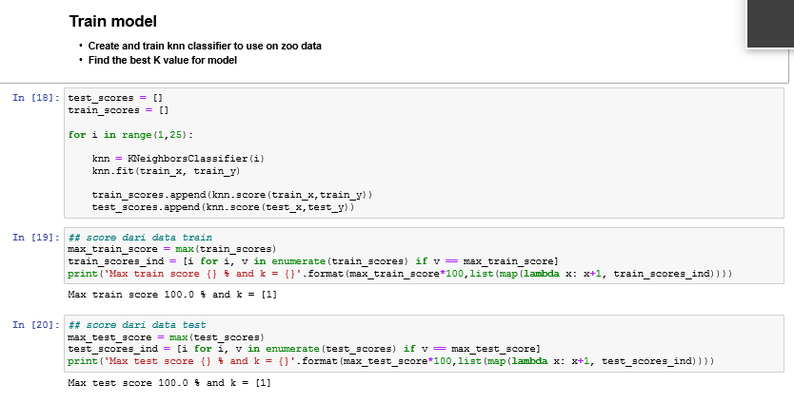
Modelling

Slide 13
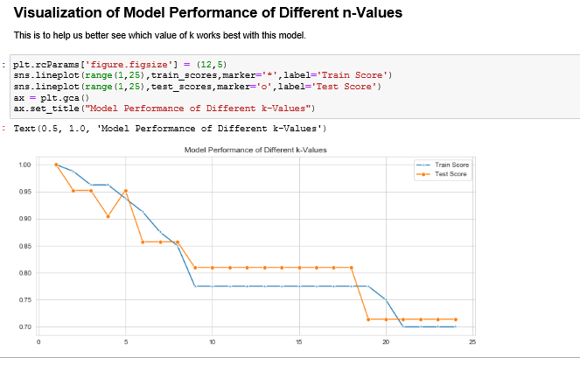
Modelling

Slide 14
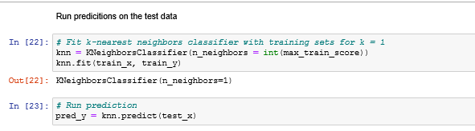
Modelling

Slide 15
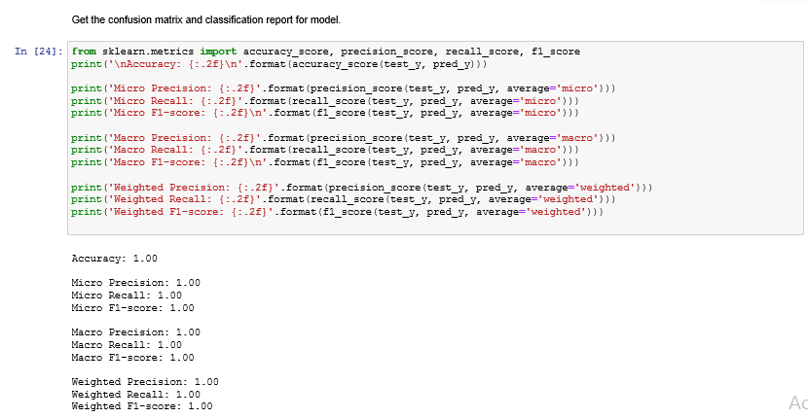
Evaluation, Deployment, & Feedback

Slide 16
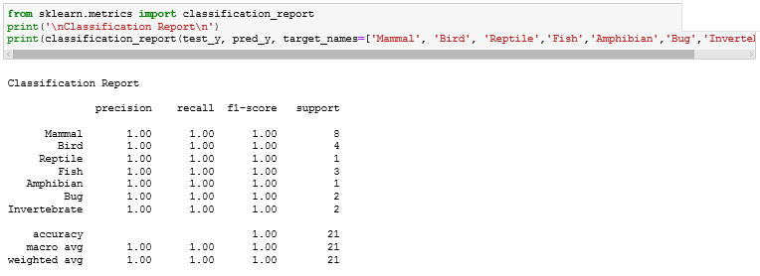
Evaluation, Deployment, & Feedback

Slide 17
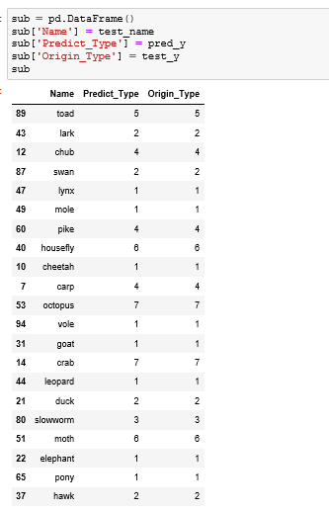
Evaluation, Deployment, & Feedback

Slide 18
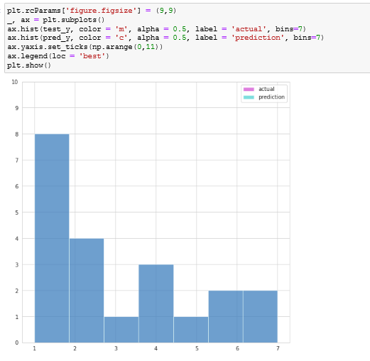

Evaluation, Deployment, & Feedback

Slide 19
TERIMA KASIH

